Slide 1

Apps In Containers Best Practices for containerised Apps
Mateusz Dymiński

Slide 2
whoami
Mateusz Dymiński
Software Developer at Nokia
8+ exp with Java
5+ exp with Go
One of the organizer GoWroc - Golang Wroclaw Meetup
Page: mateuszdyminski.com
Github: github.com/mateuszdyminski
Twitter: @m_dyminski
LinkedIn: linkedin.com/in/mdyminski

Slide 3
Agenda
Signaling in containers
Choosing container base image
Multistage builds
Security
Application configuration
Metrics in containers
Intelligent Health Checks & Graceful Shutdown
Summary

Slide 4

github.com/mateuszdyminski/app-in-container

Slide 5

Let’s Build Application

Slide 6
Users Application
Users Service
REST API
Storage: MySQL

Slide 7
User
@Entity @Table(name = "users") public class User { @Id @GeneratedValue(strategy = GenerationType.IDENTITY) private Integer id; private String firstName; private String secondName; @Temporal(TemporalType.TIMESTAMP) private Date birthDate; public Integer getId() { return id; } public String getFirstName() { return firstName; } public String getSecondName() { return secondName; } public Date getBirthDate() { return birthDate; } }

Slide 8
Users Controller
@RestController @RequestMapping("/api") public class UsersController { @Autowired UserRepository userRepository; @GetMapping("/users") public List<User> getAllUsers() { return userRepository.findAll(); } @PostMapping("/users") public User createUser(@Valid @RequestBody User user) { return userRepository.save(user); } @GetMapping("/users/{id}") public User getUserById(@PathVariable(value = "id") Integer userId) { return userRepository.findById(userId) .orElseThrow(() -> new ResourceNotFoundException("User", "id", userId)); } }

Slide 9
Demo Users Service
Build Users Service
Run
Open
$ mvn package
$ java -jar target/users-app-1.0.jar
http://localhost:8080/api/users

Slide 10
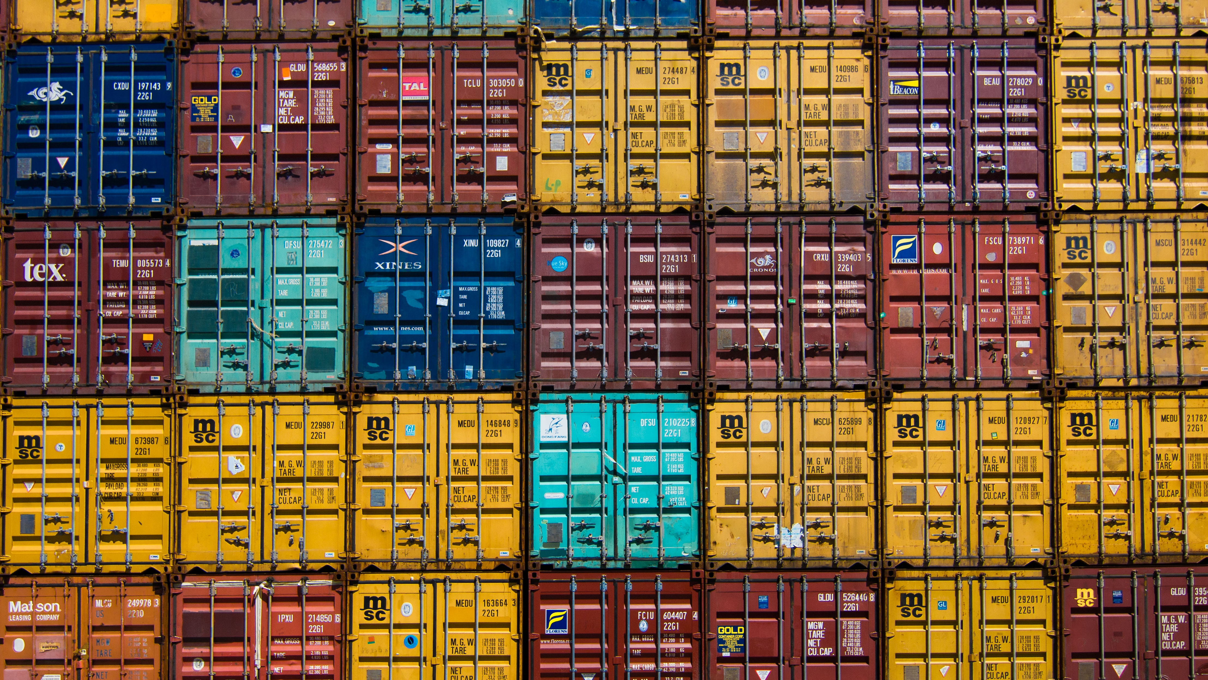
Let’s Dockerize Users App

Slide 11
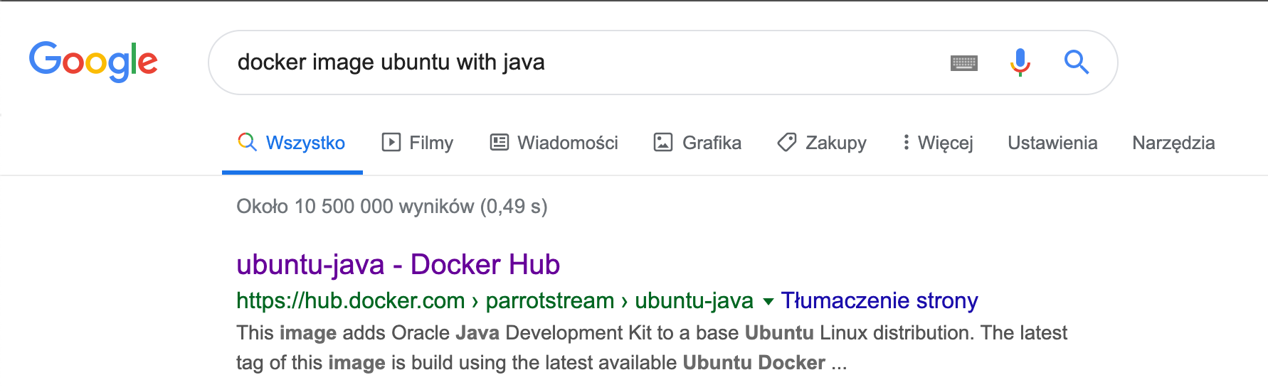

Slide 12
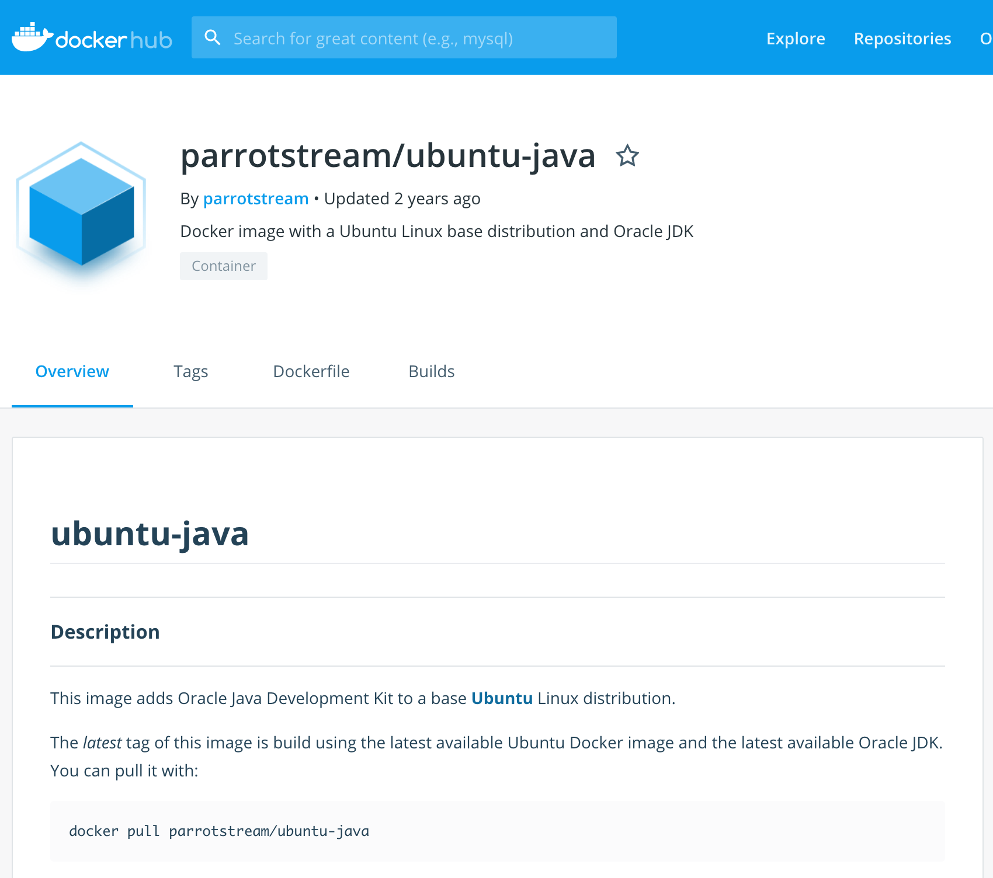

Slide 13
Our very first Dockerfile
FROM parrotstream/ubuntu-java
RUN mkdir -p /var/users-app
COPY target/users-app-1.0.jar /var/users-app/users-app-1.0.jar
COPY run.sh /var/users-app/run.sh
ENTRYPOINT "/var/users-app/run.sh"
And run.sh
#!/usr/bin/env sh
echo "Running users App" /usr/lib/jvm/java-8-oracle/bin/java -jar /var/users-app/users-app-1.0.jar

Slide 14

Let’s get ready for rumble!

Slide 15
RUN vs CMD vs ENTRYPOINT
RUN executes command(s) in a new layer and creates a new image. E.g., it is often used for installing software packages.
CMD sets default command and/or parameters, which can be overwritten from command line when docker container runs.
ENTRYPOINT configures a container that will run as an executable.

Slide 16
RUN vs CMD vs ENTRYPOINT
We have 2 options while creating RUN, ENTRYPOINT or CMD:
or different exec where command line is like JSON array:
Long story short: always use the array exec form. The shell form runs as a subcommand of /bin/sh -c which comes with a load of problems, one of them notably that you’ll never see a signal in your application.
ENTRYPOINT "/usr/bin/java -jar /var/users-app/app-1.0.jar"
ENTRYPOINT ["java”, „-jar”, ”/var/users-app/app-1.0.jar”]

Slide 17
Signaling – Script as Entrypoint
Some applications are not suited to be run in CMD or ENTRYPOINT and require some logic before they can be started
Use exec - Instead of forking a new process from the existing bash it replaces the shell
Use:
Instead of:
exec /app/bin/your-app
/app/bin/your-app

Slide 18
Signaling part - summary
Use the exec/JSON array form of ENTRYPOINT.
When Docker detects the JSON syntax, it runs the arguments directly, without a shell.
Use exec in shell entrypoints.
Don’t pipe your application’s output.
Avoid being PID 1.
Listen for SIGTERM or set STOPSIGNAL in your Dockerfile.

Slide 19
Our Dockerfile v2
FROM parrotstream/ubuntu-java
RUN mkdir -p /var/users-app
COPY target/users-app-1.0.jar /var/users-app/users-app-1.0.jar
CMD ["/usr/lib/jvm/java-8-oracle/bin/java", "-XshowSettings:VM", "-XX:NativeMemoryTracking=summary", "-jar", "/var/users-app/users-app-1.0.jar"]

Slide 20
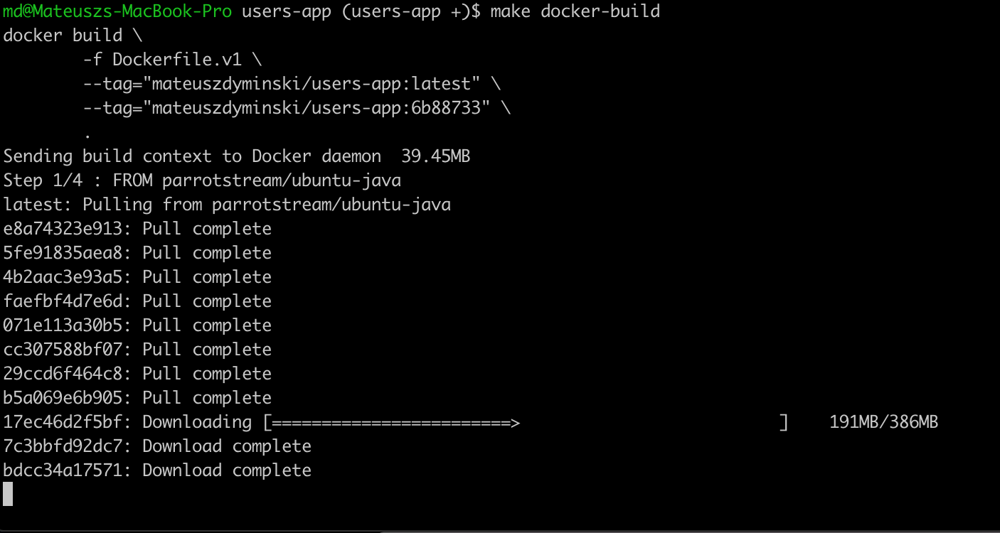


Slide 21
Checking image size
It’s 881mb !!!!!!!!!!!!!!!!!!!!!!!!!!!!!!!!

Slide 22

Choosing Container Base Image

Slide 23
First problem: Your Runtime
Depends on your programming language
JDK vs JRE in Java
Python interpreter for Python
GCC

Slide 24
Second problem: Base Linux Image
Do we rely on external OS toolbox? curl, wget, etc.
Do we really care about the size of image?
Security!
We need to choose distro which is free from CVE
Less components that can be exploited and smaller attack surface

Slide 25
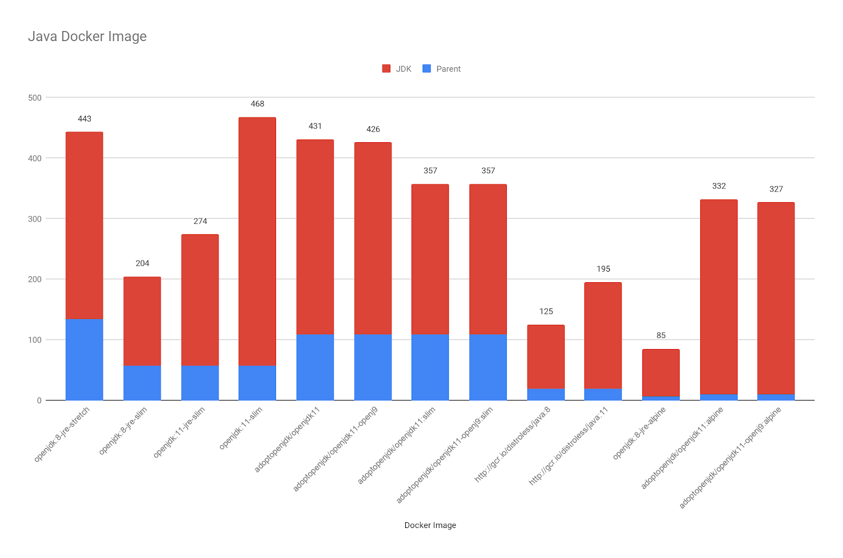

Slide 26
Alpine VS Slim
The slim images are usually based on Debian (and on the GNU C library)
Slim has been optimized for size, by removing packages
Sometimes, Slim is lack essential things (like, a compiler!)
Alpine doesn’t have libc – it has its own implementation called musl

Slide 27
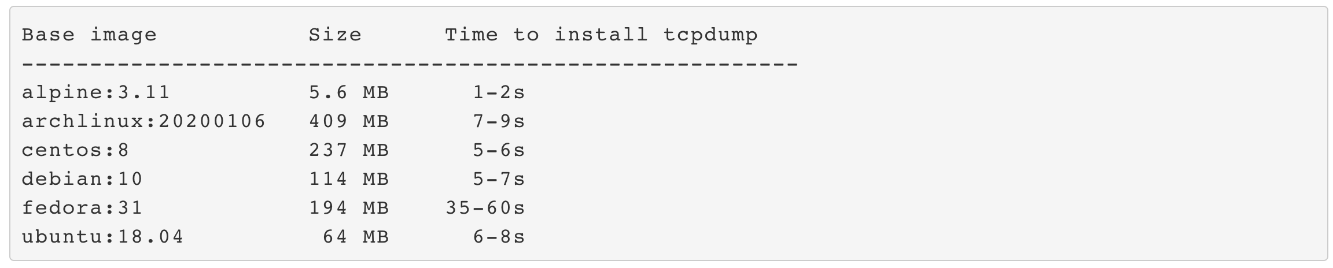
Package managers in light distributions
Source: https://www.ardanlabs.com/blog/2020/02/docker-images-part2-details-specific-to-different-languages.html

Slide 28

Let’s get Alpine then

Slide 29
Alpine
Lightweight Linux distribution based on musl libc and busybox
musl is a “libc”, an implementation of the standard library functionality described in the ISO C
uses its own package manager, apk.
Alpine was brought to the spotlight when people realized that it would make an excellent distribution for containers.

Slide 30
Our Dockerfile 3
FROM openjdk:8-jre-alpine
RUN mkdir -p /var/users-app
COPY target/users-app-1.0.jar /var/users-app/users-app-1.0.jar
ENTRYPOINT ["java", "-XshowSettings:VM", "-XX:NativeMemoryTracking=summary", "-jar", "/var/users-app/users-app-1.0.jar"]

Slide 31
Checking image size
It’s 124mb !!!!!!!!!!!!!!!!!!!!!!!!!!!!!!!!
Was 881mb

Slide 32

How About Other Languages

Slide 33
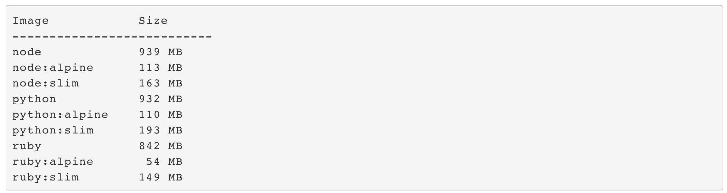
Node, Python, Ruby
Source: https://www.ardanlabs.com/blog/2020/02/docker-images-part2-details-specific-to-different-languages.html

Slide 34
Let’s change business logic

Slide 35
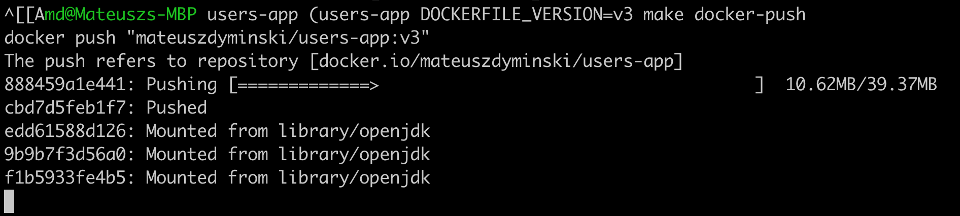

Problem:

Slide 36
Solution: Unpack Fat JAR
Build Users Service
Unpack JAR to create external and internal deps:
$ mvn clean package
$ mkdir target/dependency
$ (cd target/dependency; tar -zxf ../*.jar)

Slide 37
Our Dockerfile 4
FROM openjdk:8-jre-alpine
RUN mkdir -p /var/users-app
COPY target/dependency/BOOT-INF/lib /var/users-app/lib
COPY target/dependency/META-INF /var/users-app/META-INF
COPY target/dependency/BOOT-INF/classes /var/users-app
CMD [ "java", \
"-XshowSettings:VM", \
"-XX:NativeMemoryTracking=summary", \
"-cp", "/var/users-app:/var/users-app/lib/*", \
"com.example.users.UsersApp"]

Slide 38
Pros of unpacking JAR
Really fast Docker builds
Only real changes are send over the network to Registry
Less space are ocupied both on Local machine and Registry

Slide 39
Docker Build Caching
For most commands, if the text of the command hasn’t changed, the version from the cache will be used.
For COPY, it also checks that the files you’re copying haven’t changed.
If the cache can’t be used for a particular layer, all subsequent layers won’t be loaded from the cache.
Golden rule: things which change frequently should be at the end of the Dockerfile

Slide 40
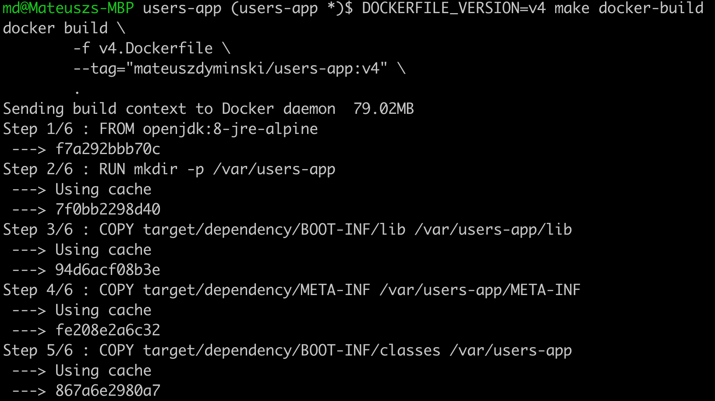

Another Problem(s)
We need to build out Java App on our local machine

Slide 41

Solution: Multistage Builds

Slide 42
Docker Multi-stage Builds
Multi-stage builds come from a simple idea:
“I don’t need to include the C or Go compiler and the whole build toolchain in my final application image. I just want to ship the binary!”
We obtain a multi-stage build by adding another FROM line in our Dockerfile.

Slide 43
Solution: Multistage Builds
FROM openjdk:8-jdk-alpine as build
WORKDIR /workspace/users-app
COPY mvnw .
COPY .mvn .mvn
COPY pom.xml .
COPY src src
RUN ./mvnw install -DskipTests
RUN mkdir -p target/dependency && (cd target/dependency; jar -xf ../*.jar)
FROM openjdk:8-jre-alpine
RUN mkdir -p /var/users-app ARG DEPENDENCY=/workspace/users-app/target/dependency COPY --from=build ${DEPENDENCY}/BOOT-INF/lib /var/users-app/lib
COPY --from=build ${DEPENDENCY}/META-INF /var/users-app/META-INF
COPY --from=build ${DEPENDENCY}/BOOT-INF/classes /var/users-app
ENTRYPOINT [ "java", \
"-XshowSettings:VM", \
"-XX:NativeMemoryTracking=summary", \
"-cp", "/var/users-app:/var/users-app/lib/*", \
"com.example.users.UsersApp"]
BUILD
Run

Slide 44
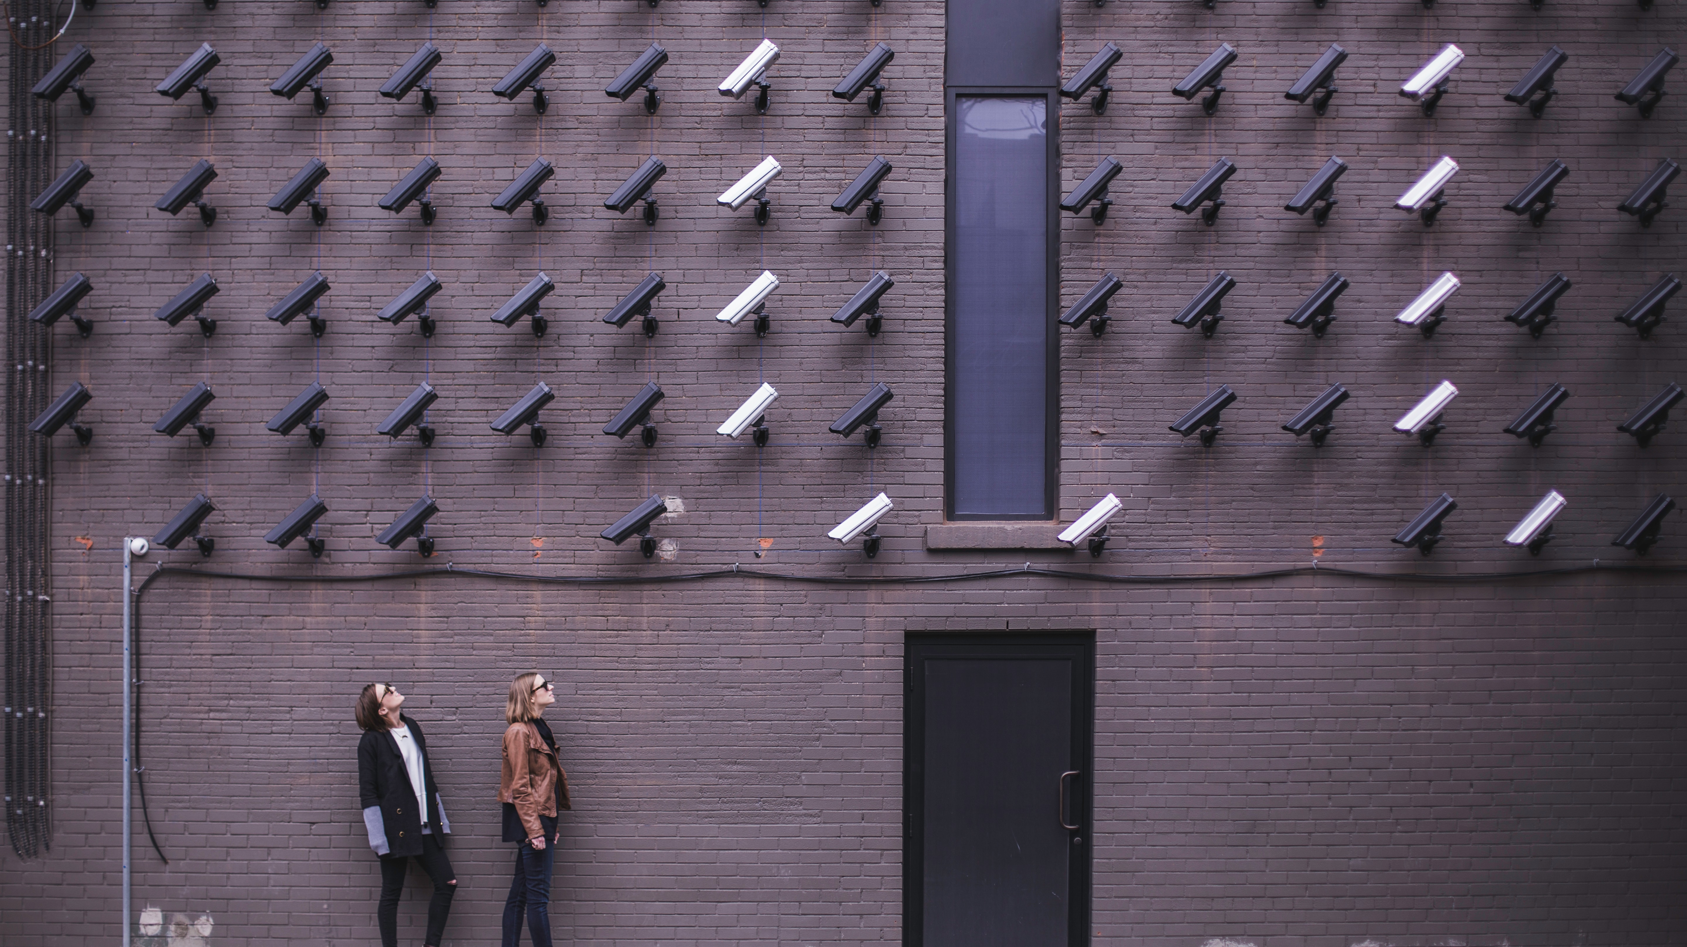
Security

Slide 45
1. Use minimal base images
The less things is in your container the better
Prefer minimal images that bundle only the necessary system tools and libraries required to run your project
Great example Google Distroless

Slide 46
Google Distroless
"Distroless" images contain only your application and its runtime dependencies.
They do not contain package managers
They do not contain shells - no /bin/sh or /bin/bash
Or any other programs you would expect to find in a standard Linux distribution.
More: github.com/GoogleContainerTools/distroless

Slide 47
Google Distroless
Container prepared for languages:
Java
Python
Python 3
Golang
Node.js
dotnet
Rust

Slide 48
Our Dockerfile 6
FROM openjdk:8-jdk-alpine as build
WORKDIR /workspace/users-app
COPY mvnw .
COPY .mvn .mvn
COPY pom.xml .
COPY src src
RUN ./mvnw install -DskipTests
RUN mkdir -p target/dependency && (cd target/dependency; jar -xf ../*.jar)
FROM gcr.io/distroless/java:11
RUN mkdir -p /home/app/users-app
ARG DEPENDENCY=/workspace/users-app/target/dependency
COPY --from=build ${DEPENDENCY}/BOOT-INF/lib /home/app/users-app/users-app/lib
COPY --from=build ${DEPENDENCY}/META-INF /home/app/users-app/users-app/META-INF
COPY --from=build ${DEPENDENCY}/BOOT-INF/classes /home/app/users-app/users-app
ENTRYPOINT [ "java", \
"-XshowSettings:VM", \
"-XX:NativeMemoryTracking=summary", \
"-cp", "/home/app/users-app/users-app:/home/app/users-app/users-app/lib/*", \
"com.example.users.UsersApp"]
Magic

Slide 49
Google Distroless
Pro Tip – latest is not always bad
$ docker build --pull .

Slide 50
2. Do not use root user
FROM openjdk:8-jdk-alpine as build
WORKDIR /workspace/users-app
COPY mvnw .
COPY .mvn .mvn
COPY pom.xml .
COPY src src
RUN ./mvnw install -DskipTests
RUN mkdir -p target/dependency && (cd target/dependency; jar -xf ../*.jar)
FROM openjdk:8-jre-alpine
RUN addgroup -S app && adduser -S -G app app
USER app
RUN mkdir -p /home/app/users-app
ARG DEPENDENCY=/workspace/users-app/target/dependency
COPY --from=build ${DEPENDENCY}/BOOT-INF/lib /home/app/users-app/users-app/lib
COPY --from=build ${DEPENDENCY}/META-INF /home/app/users-app/users-app/META-INF
COPY --from=build ${DEPENDENCY}/BOOT-INF/classes /home/app/users-app/users-app
ENTRYPOINT [ "java", \
"-XshowSettings:VM", \
"-XX:NativeMemoryTracking=summary", \
"-cp", "/home/app/users-app/users-app:/home/app/users-app/users-app/lib/*", \
"com.example.users.UsersApp"]
Magic

Slide 51
3. Sign and verify images
Do that to mitigate MITM attacks
Docker defaults allow pulling Docker images without validating their authenticity
Prefer Docker Certified images that come from trusted partners
export DOCKER_CONTENT_TRUST=1

Slide 52
4. Check vulnerabilities
Use static Security Analysis tools like: clair or snyk

Slide 53

Clair-Scanner
Client for Clair - github.com/arminc/clair-scanner
Usage:
$ clair-scanner alpine:3.5
2017/09/24 11:20:24 [INFO] Start clair-scanner
2017/09/24 11:20:24 [INFO] Server listening on port 9279
2017/09/24 11:20:24 [INFO] Analyzing 693bdf455e7bf0952f8a4539131 2017/09/24 11:20:24 [INFO] Image [alpine:3.5] not vulnerable
$ clair-scanner alpine:3.4
2019/09/24 11:16:41 [INFO] Start clair-scanner
2019/09/24 11:16:41 [INFO] Server listening on port 9279
2019/09/24 11:16:41 [INFO] Analyzing 693bdf455e7bf0952f8a45131323 2017/09/24 11:16:41 [CRIT] Image contains unapproved vulnerabilities: [CVE-2016-9840 CVE-2016-9841 CVE-2016-9842 CVE-2016-9843]

Slide 54
5. Don’t put sensitive data to Docker images
Using Multi-stage Builds
Using Docker Secret
FROM ubuntu as intermediate
WORKDIR /app COPY secret/key /tmp/
RUN scp -i /tmp/key build@acme/files .
FROM ubuntu
WORKDIR /app
COPY --from=intermediate /app .
FROM openjdk:8-jdk-alpine
RUN --mount=type=secret,id=mysecret cat /run/secrets/mysecret

Slide 55
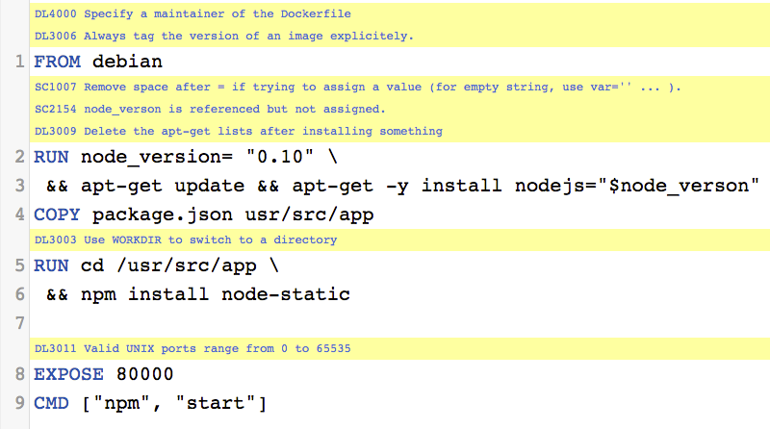
6. Use Linter
Example: github.com/hadolint/hadolint
Source: https://github.com/hadolint/hadolint

Slide 56
6. Use Fixed Tags
Use fixed tags like: golang:1.13.8-alpine3.10

Slide 57
7. Use COPY instead of ADD
COPY takes in a src and destination. It only lets you copy in a local file or directory from your host (the machine building the Docker image) into the Docker image itself.
ADD lets you do that too, but it also supports 2 other sources. First, you can use a URL instead of a local file / directory. Secondly, you can extract a tar file from the source directly into the destination.

Slide 58

Application Configuration

Slide 59
Application Configuration in Docker
Do not hardcode configuration in Dockerfile!!!
Do not put configuration files in your Docker directly
It violates 12 Factor app - https://12factor.net/
Security problem
Use ENV variables
Mount volume with configuration file

Slide 60
Application Configuration in Docker
Put ENV variable directly in Dockerfile
FROM alpine:3.11.3
# Application Configuration
ENV HTTP_PORT="8080"
# Copy binary
COPY app /usr/local/bin/app
# Exec
CMD ["app"]
$ docker run –e HTTP_PORT=“8090” app:1.0

Slide 61
Application Configuration in Docker
Put config values in file
FROM alpine:3.11.3
# Application Configuration
ENV CONFIG_PATH=”/config/config.toml"
# Copy binary
COPY app /usr/local/bin/app
# Exec
CMD ["app"]
$ docker run -p 8080:8080 -v $PWD/config:/config app:1.0

Slide 62
Application Configuration Docker + K8s
Put config in ConfigMap
apiVersion: v1
kind: ConfigMap
metadata:
name: app-config
data:
# Config could be pair: key-value
message: Hello World!
foo: bar
# Or set as complete file contents
keys: |
message=Hello World
foo=bar

Slide 63
And Run Container in K8s Deployment
apiVersion: apps/v1
kind: Deployment
metadata:
…
containers:
- name: app
image: mateuszdyminski/app-container-reload:latest
imagePullPolicy: Always
volumeMounts:
- mountPath: /config
name: config-volume
ports:
- containerPort: 8080
volumes:
- name: config-volume
configMap:
name: app-config

Slide 64
Kubernetes Config Autoreload
Reload application configuration when something in ConfigMap has changed
We need to support it in code
Popular pattern – dedicated endpoint + pod sidecar
app.router.HandleFunc("/-/reload", app.reloadHandler).Methods(http.MethodPost)
func (a *app) reloadHandler(w http.ResponseWriter, r *http.Request) {
a.loadConfig()
}

Slide 65
Docker + K8s extra configuration feature
apiVersion: apps/v1
kind: Deployment
metadata:
…
containers:
- name: app
image: mateuszdyminski/app-container-reload:latest
imagePullPolicy: Always
volumeMounts:
- mountPath: /config
name: config-volume
ports:
- containerPort: 8080
- name: reloader
image: jimmidyson/configmap-reload:v0.3.0
args:
- --volume-dir=/config
- --webhook-url=http://127.0.0.1:8080/-/reload
volumeMounts:
- name: config-volume
mountPath: /config
volumes:
- name: config-volume
configMap:
name: app-config

Slide 66
Application Configuration

Slide 67
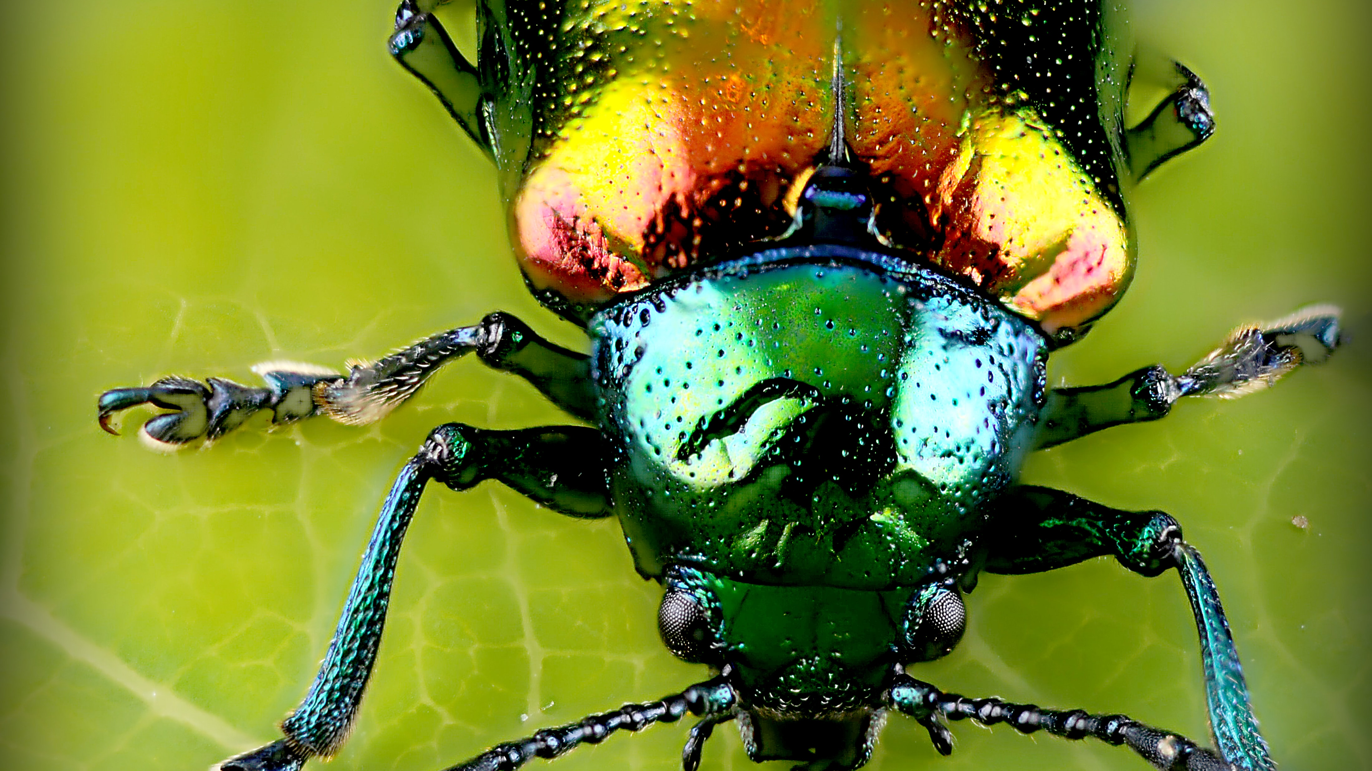
Debug

Slide 68
Debug
We need to be sure that we will be able to debug out application on production!
It’s vary depend on programming language
Expose proper ports for debug purpose
Expose proper ports for profiling purpose
Remember about security – expose ports only to outside of the docker not outside of the cluster/to the end clients
We should not `docker exec` or `kubectl exec`

Slide 69

Container Instrumentation Metrics

Slide 70
Container Instrumentation
Current standard – Prometheus
If configured properly – automatically fetches basic info about container – CPU, Memory etc.
If code instrumentation needed - we need to integrate it
Metrics are available under http endpoint, usually /metrics

Slide 71
Container Instrumentation Types
Long lived apps
Simple solution - expose metrics via /metrics endpoint
Long lived apps with adapter
For example Java applications with JMX
We need to create sidecar container to expose JMX metrics (JMX exporter)over http endpoint
Ephemeral jobs
Metrics are send to Long Live daemon (Prometheus Pushgateway)
Prometheus scrapes metrics from Prometheus Pushgateway instead of our container

Slide 72
Demo

Slide 73
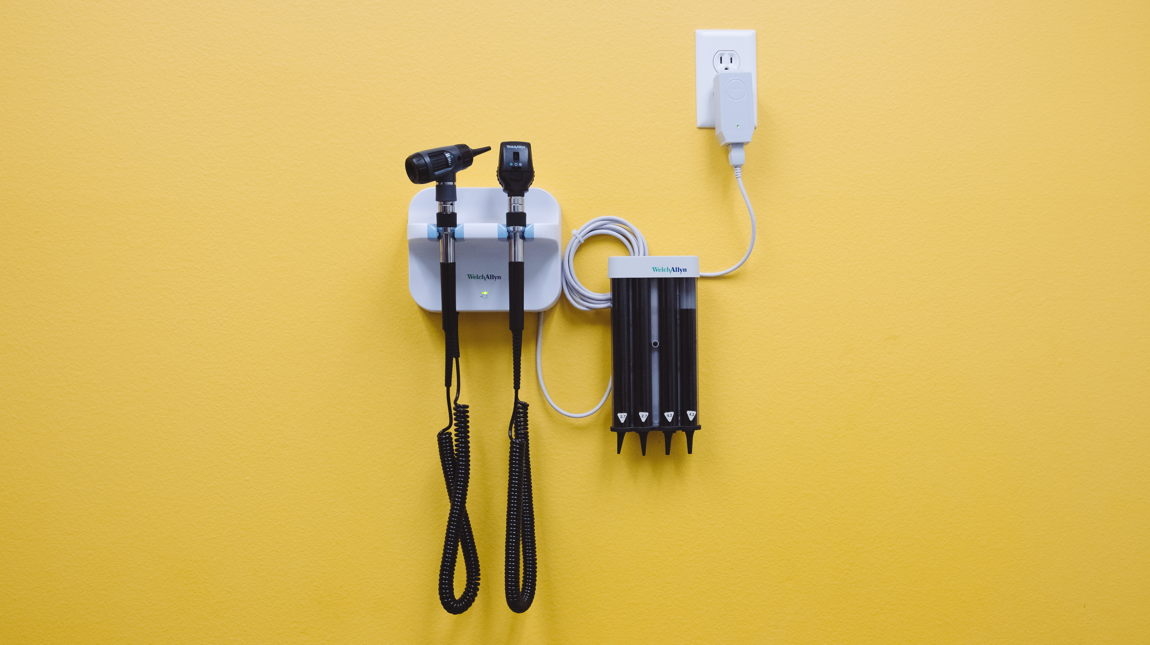
Intelligent Health Checks

Slide 74
Do I Really Need Health Checks?

Slide 75
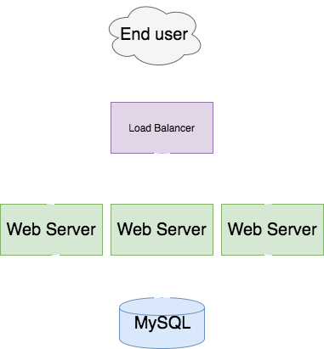

Slide 76
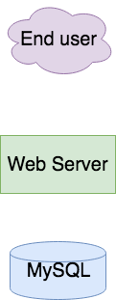
Do I need health checks in following architecture?

Slide 77
Intelligent Health Checks - Healthz
It leverage health endpoint pattern.
Historically comes from Google’s internal practices.
Helps with Kubernetes Rolling Update
Adds many important information about the health of our service:
Deployed version
Uptime
Hostname
Git statistics
Health of external services - DB, Cache etc

Slide 78
Demo

Slide 79
Health Checks in Kubernetes
Readiness - probes are designed to let Kubernetes know when your app is ready to serve traffic.
Liveness - probes let Kubernetes know if your app is alive or dead. If you app is alive, then Kubernetes leaves it alone. If your app is dead, Kubernetes removes the Pod and starts a new one to replace it.

Slide 80

Graceful Shutdown

Slide 81
Graceful Shutdown
We can speak about the graceful shutdown of our application, when all of the resources it used and all of the traffic and/or data processing what it handled are closed and released properly.
It means that no database connection remains open and no ongoing request fails because we stop our application.

Slide 82
Graceful Shutdown with Kubernetes
App receives SIGTERM signal because Kubernetes wants to stop it
App (pod) starts to return 500 for GET /health to let readinessProbe(Service) know that it's not ready to receive more requests.
Kubernetes readinessProbe checks GET /health and it stops redirecting traffic to the app (because it continuously returns 500)
App waits before it starts to shutdown - to make sure that the Service is getting notified via readinessProbe fail
App starts graceful shutdown
App first closes server with live working DB connections
App exits process
Kubernetes force kills the application after 30s (SIGKILL) if it's still running (in an optimal case it doesn't happen)

Slide 83
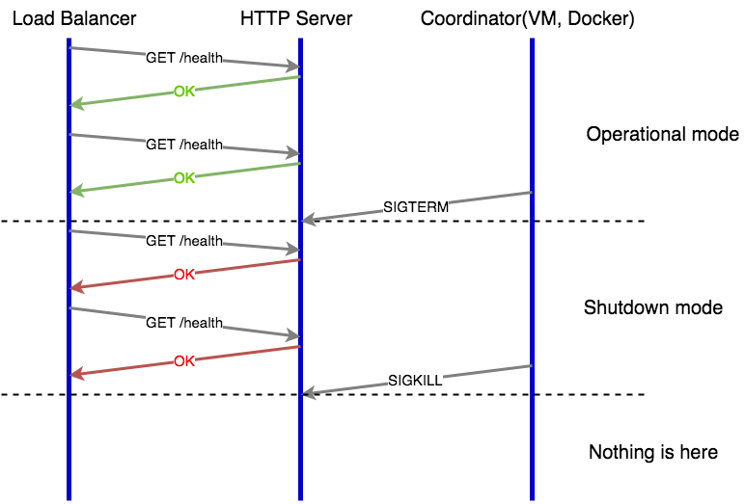
Web Server Graceful Shutdown

Slide 84
Graceful Shutdown with Golang
// subscribe to SIGTERM signals
quit := make(chan os.Signal)
signal.Notify(quit, os.Interrupt, syscall.SIGTERM)
// blocks the execution until os.Interrupt or syscall.SIGTERM signal appears
<-quit
log.Println("shutting down server. waiting to drain the ongoing requests...")
rest.Unhealthy()
// add extra time to prevent new requests be routed to our service
time.Sleep(5 * time.Second)
// shut down gracefully, but wait no longer than the Timeout value (default 20s).
ctx, cancelF := context.WithTimeout(context.Background(), Timeout*time.Second)
defer cancelF()
// shutdown the http server
if err := srv.Shutdown(ctx); err != nil {
log.Printf("error while shutdown http server: %v\n", err)
}
log.Println("server gracefully stopped")

Slide 85
Graceful Shutdown with Golang
// Unhealthy sets server health to false - used in gracefull shutdown mode
func (r *UserRest) Unhealthy() {
r.mu.Lock()
defer r.mu.Unlock()
r.healthy = false
}
// Health handler is responsible for serving resonse with current health status of service.
func (r *UserRest) Health(w http.ResponseWriter, req *http.Request) {
r.mu.Lock()
defer r.mu.Unlock()
if r.healthy {
resp := HealthStatus{
Hostname: r.hostname,
StartedAt: r.startedAt.Format("2006-01-02_15:04:05"),
Uptime: time.Now().UTC().Sub(r.startedAt).String(),
Build: r.buildInfo,
}
WriteJSON(w, resp)
} else {
WriteErr(w, fmt.Errorf("Server in graceful shutdown mode"), http.StatusInternalServerError)
}
}

Slide 86
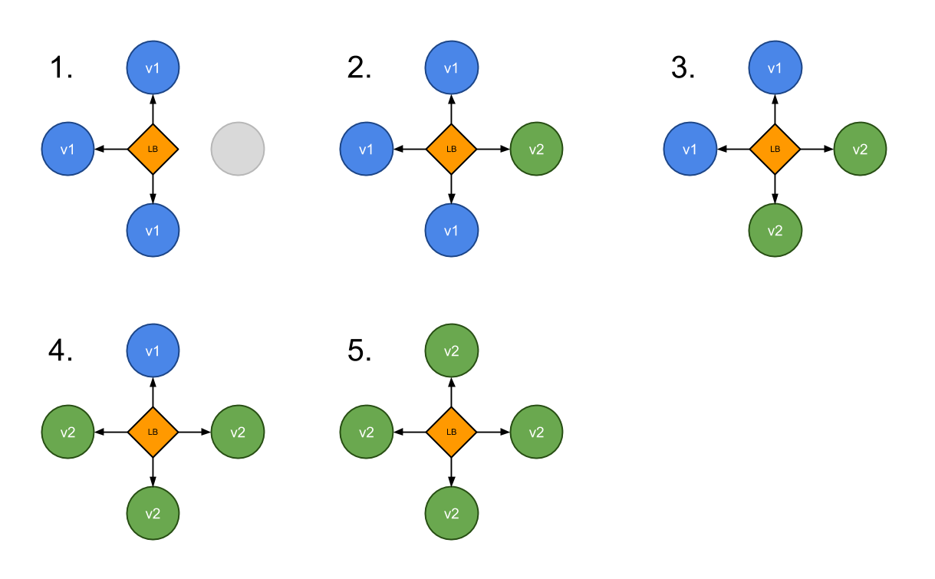
Rolling Update with Kubernetes
Thanks to combination of Graceful Shutdown and Rolling Update we can not loose not even single request

Slide 87

Summary

Slide 88
Takeaways
Always use array/JSON in ENTRYPOINT/CMD
Use multi-stage builds
Choose minimal container
Don’t run your container app as root!
If you don’t need to maintain your own Dockerfile – use Google Distroless
Remember about operability – health checks, metrics, debugability
Prepare your app for Graceful Shutdown

Slide 89
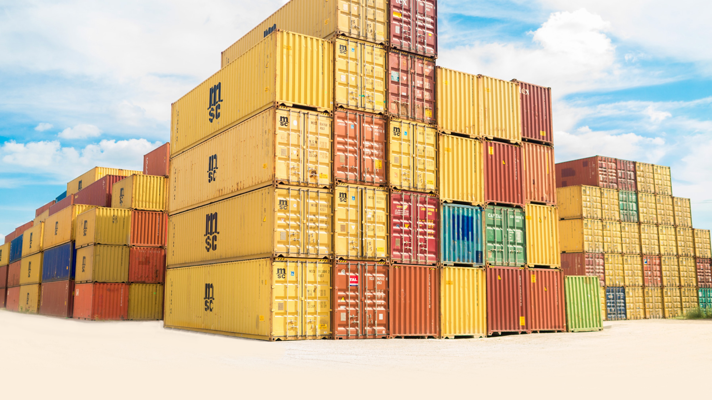
Hopefully your containers would look like

Slide 90

Not like

Slide 91
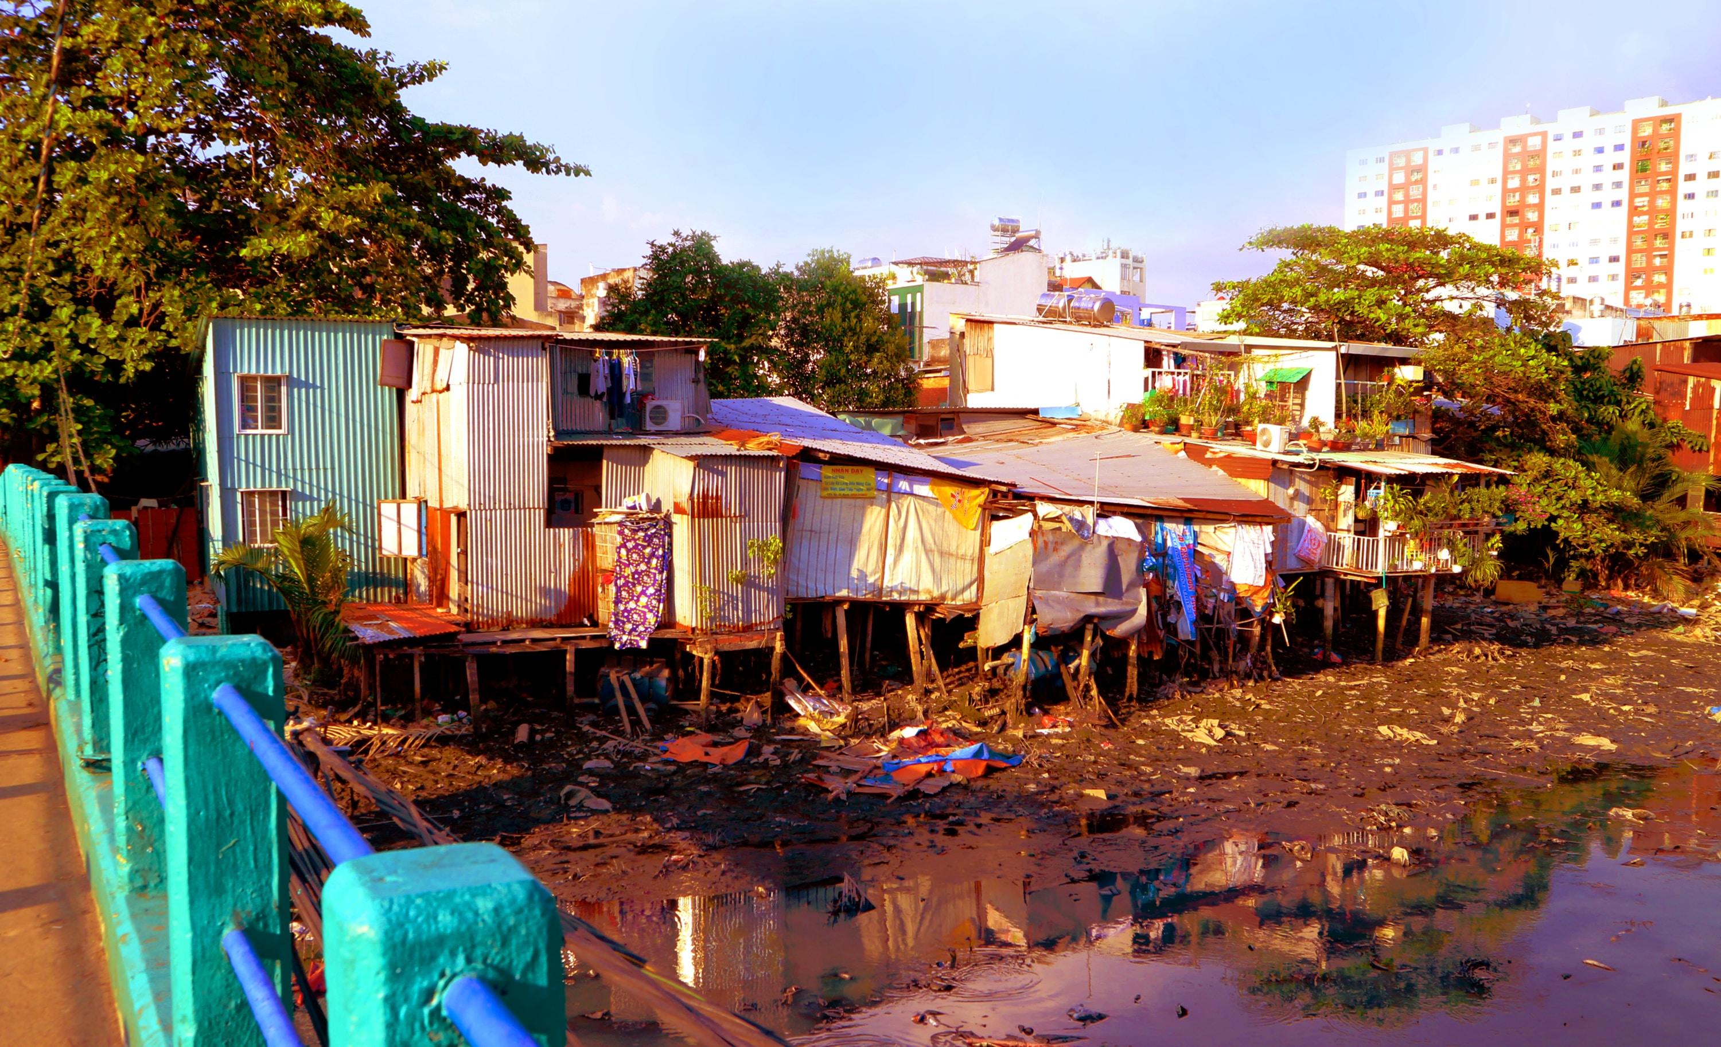
Not like

Slide 92

Not like

Slide 93

Q&A

